Slide 1
Sarvalanche -S1 Avalanche Detection Pipeline
Dr. Zachary Hoppinen
February 2026

Slide 2
What is sarvalanche
Python package that handles data finding, reprojection, differencing, and detection for avalanche debris. Pytest implemented.
How does it work? Combines static probabilities of avalanches debris (slope, fcf, runout probability, water mask) with SAR features (local resolution weighted backscatter change currently)
IO – we get S1 (opera rtcs, local resolution), forest cover, slope angles, UCLA snowmodel SWE, and run the FlowPy debris flow model over a dem to generate runout cell counts.

Slide 3
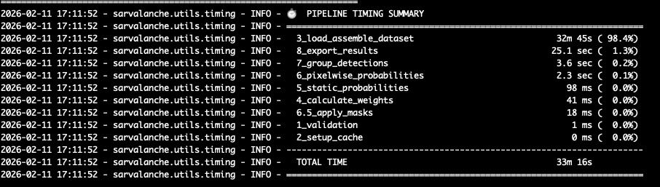
What is sarvalanche
Runtime – over most of Sawtooth Mountains full run (including flowpy modeling (95% of time) takes 33 minutes. Non-flowpy run time = 2 minutes, data-loaded already = <1 minute.

Slide 4
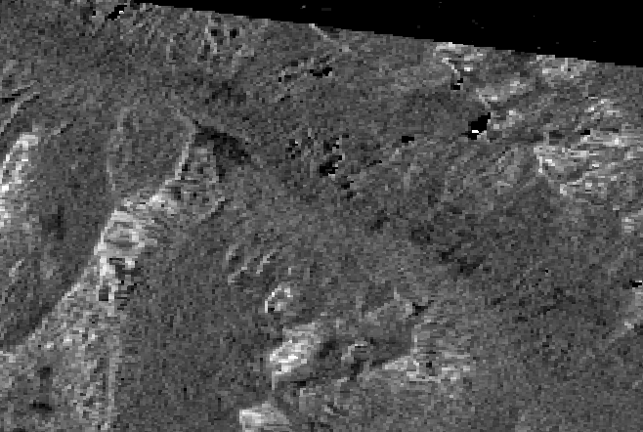
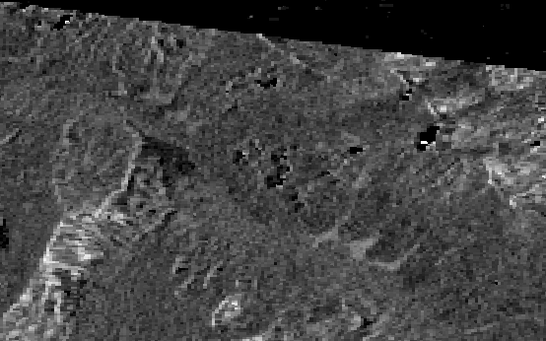
Example
March 31st – Major earthquake triggered avalanche cycle in the Sawtooths
Before – March 30th – Track 71
Avalanches – April 5th – Track 71

Slide 5
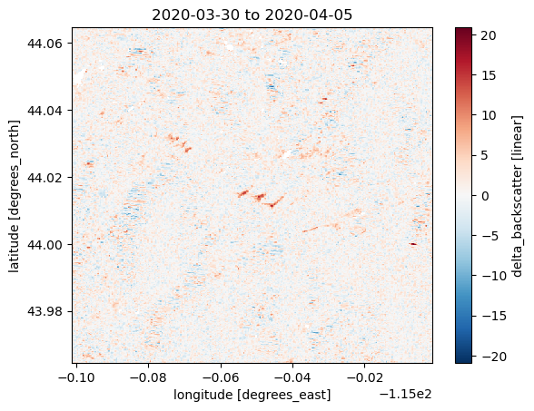
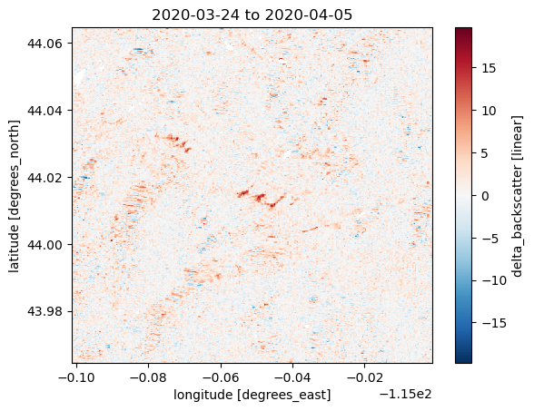
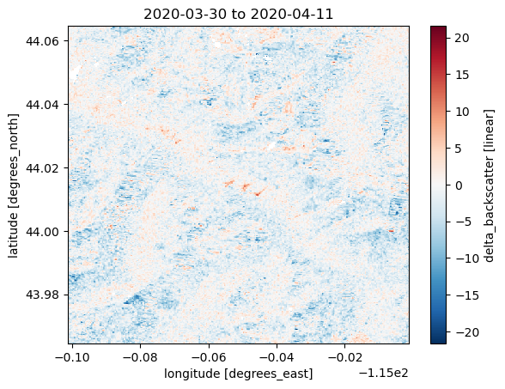
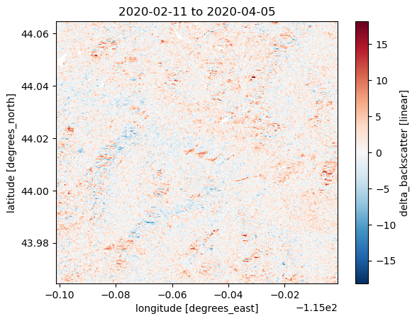
We start with dB of backscatter change over specific date (2020-03-31) from each track from all possible pairs (within a few months). These are all examples crossing 3/31 from same orbit geometry.

Slide 6
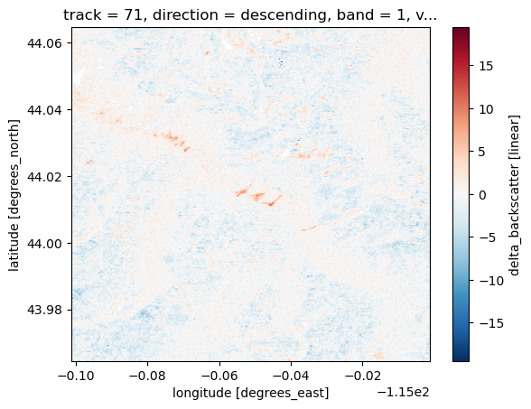
These are weighted by temporal distance between each pair to generate a track based mean change that weights closer pairs more
w_temporal = np.exp(-np.abs(dt_days) / tau_days)
With tau_days = 24 currently

Slide 7
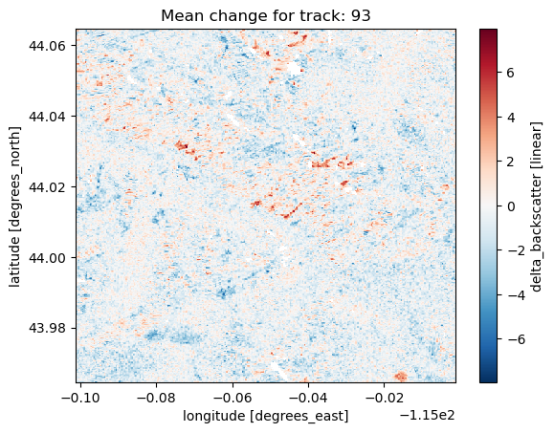
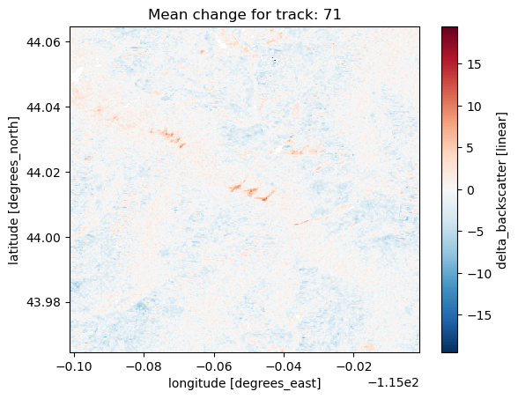
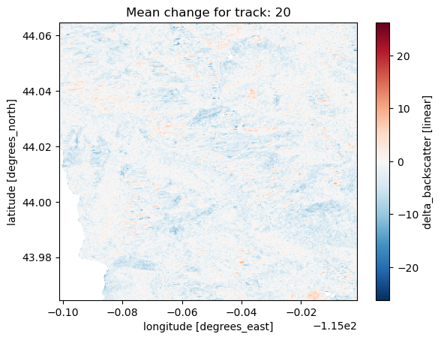
This is repeated for all available tracks

Slide 8
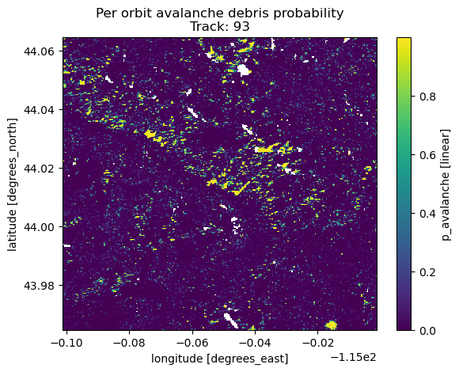
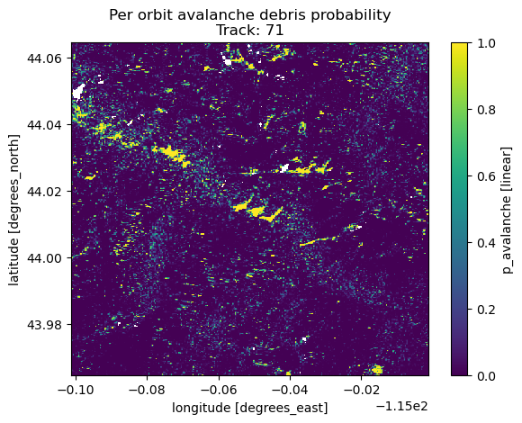
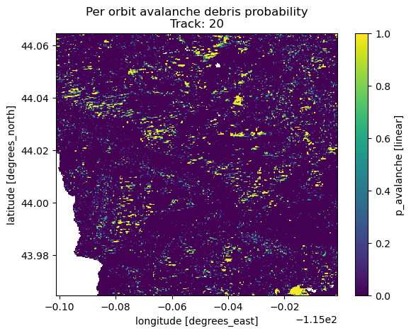
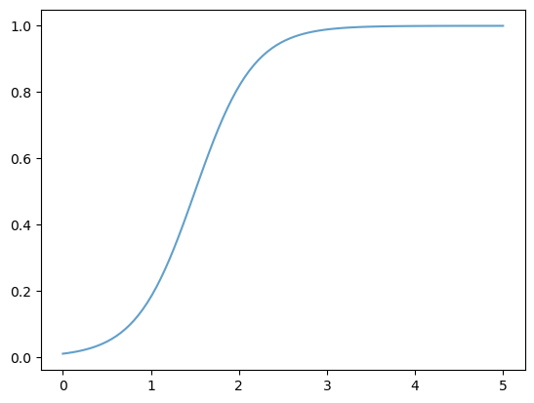
We convert this mean change to a probability
prob = scipy.expit(diff - threshold_db)*logistic_slope
We show the probability to backscatter change to the right

Slide 9
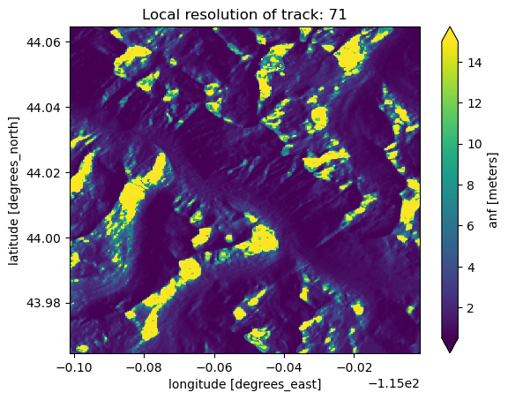
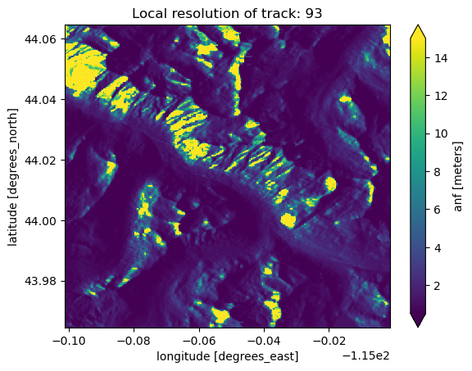
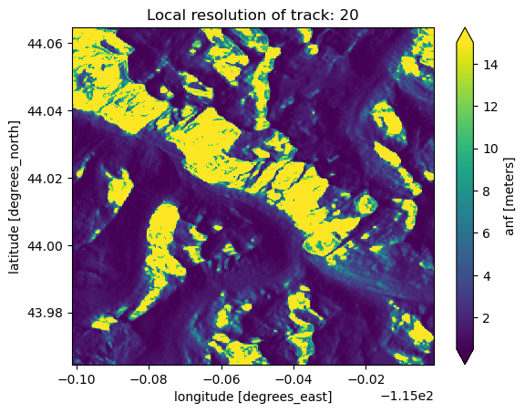
These are then combined using the inverse of local resolution of each pixel to weight the relative tracks.
So lower local resolution == less weight for final probability
We also use a relative weighting of VV vs VH (1.0 vs 0.8)

Slide 10
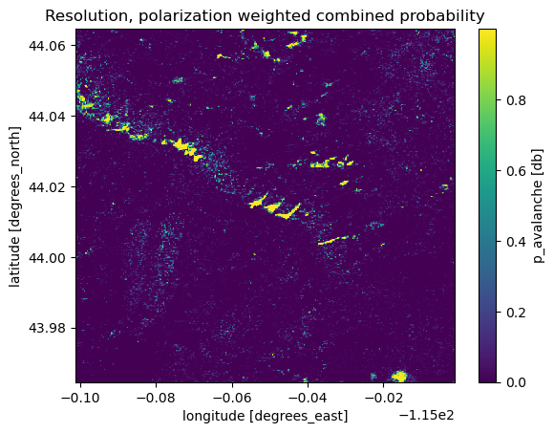
Combining probabilities from multiple tracks
Log-odds combination
log_odds = np.log(probs_safe / (1 - probs_safe))
# Weighted average in log-odds space. Weight is inverse of local resolution
log_odds_combined = (log_odds * weights).sum(dim=dim)
# Convert back to probability
p_combined = 1 / (1 + np.exp(-log_odds_combined))
Boosting:
probs_filtered = probs.where(probs >= min_prob_threshold)
# Count valid sources (how many detect something)
n_valid = probs_filtered.notnull().sum(dim=dim)
n_total = probs.sizes[dim]
# Agreement: fraction showing detection
agreement = n_valid / n_total
# Boost formula: p_final = p_mean + (1 - p_mean) × agreement² × strength
boost = (1 - p_combined) * (agreement ** 2) * agreement_strength
p_combined = p_combined + boost

Slide 11
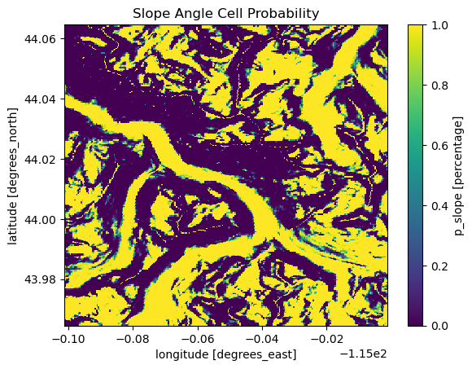
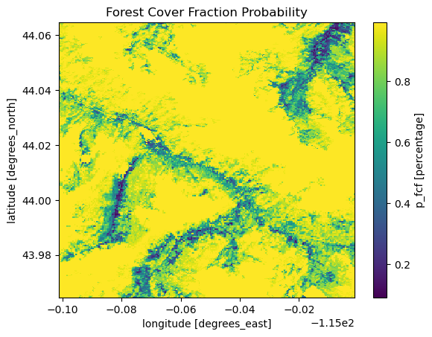
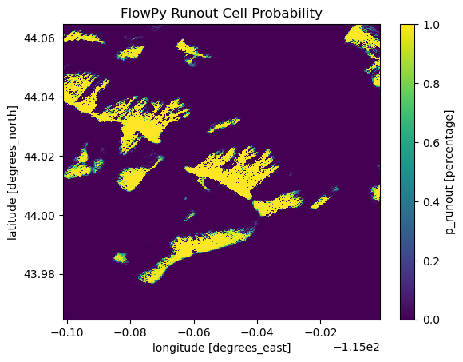
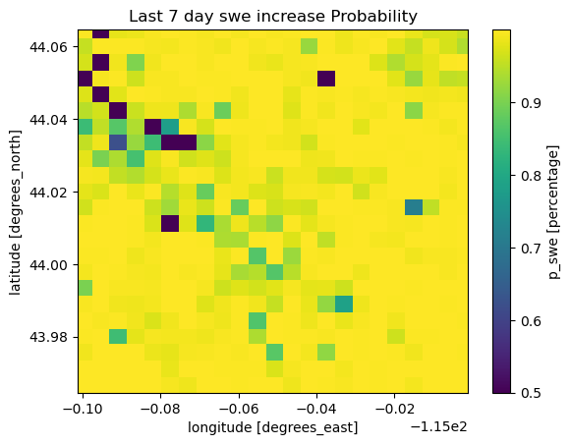
This is then combined (geometric mean this time) with non-SAR probabilities

Slide 12
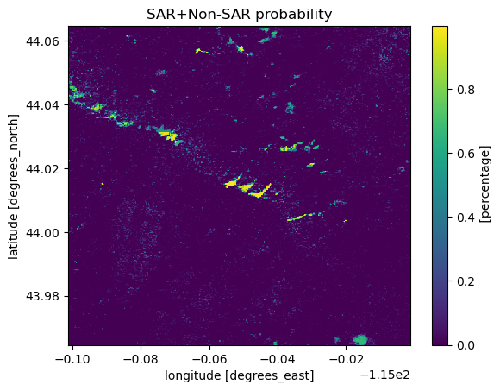
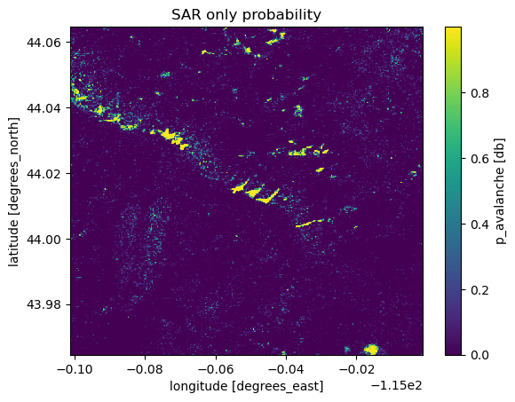
We just multiple pooled non-SAR probabilities * SAR probability.
Non-SAR layers can not increase pixel-wise probability from SAR results but can decease it.
Reduces probability when 1. not in runout zones, 2. steep angle, 3. high fcf, 4. little recent SWE.
Completely masks: urban and water

Slide 13
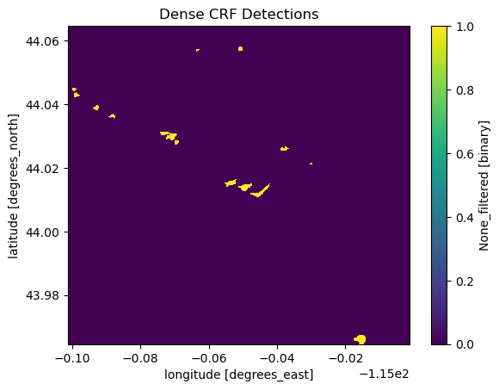
Last step: Use dense conditional random fields (CRF) to give weight to pixels near other debris pixels and remove sharp changes in debris/background

Slide 14
Re state example with dectionsExample
March 31st – Major earthquake triggered avalanche cycle in the Sawtooths
Avalanches – April 5th – Track 71

Slide 15
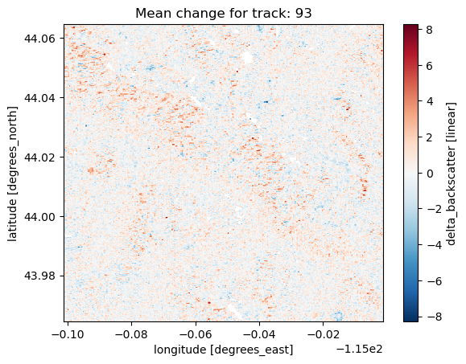
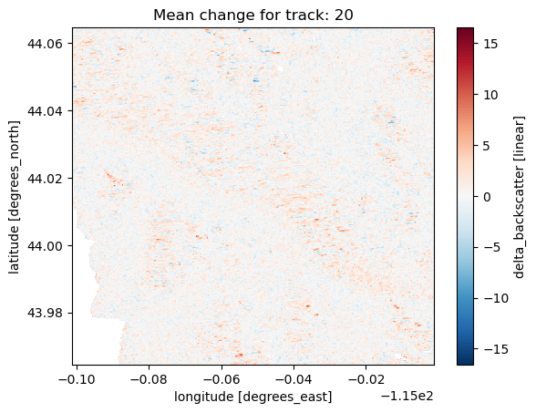
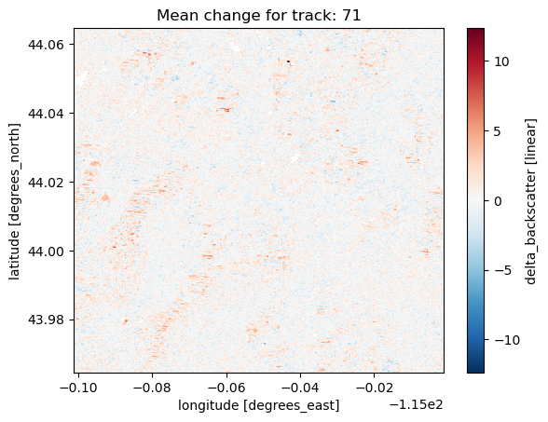
Re-run again on Jan 31st, 2020 for an example of minimal avalanches

Slide 16
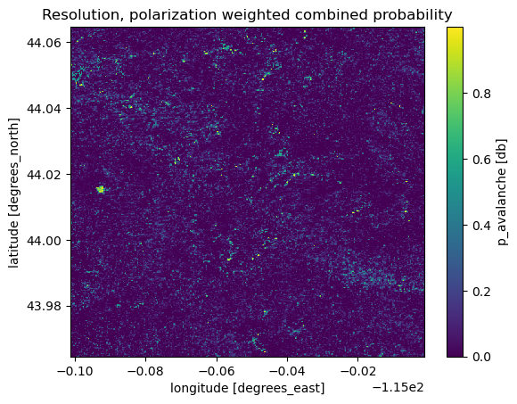
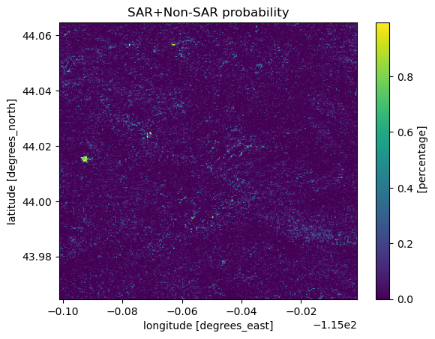
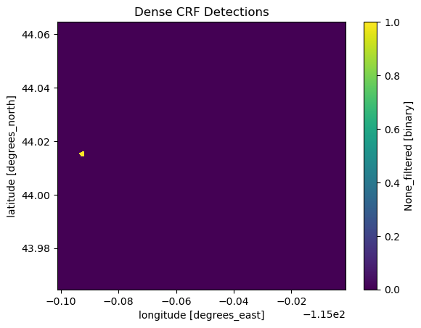
Re-run again on Jan 31st, 2020 for an example of minimal avalanches
Single detection for
non-avalanche date

Slide 17
Next Steps?
ISSW presentation – run over last 5 years over each of the western US avalanche regions to generate database for other researchers. What level of temporal specificity? Yearly? Monthly? Daily?
Processing improvements:
Multi-temporal. When does an avalanche first appear in a SAR scene = set as detection date.
Use backscatter distributional changes in addition to backscatter change
Use empirical detections to train ML model (unet) based on empirical detections and then re-run and capture more detections
Incorporate other/more sentinel-1 coherence and NISAR based pixel based probability pipelines.

